Slide 1
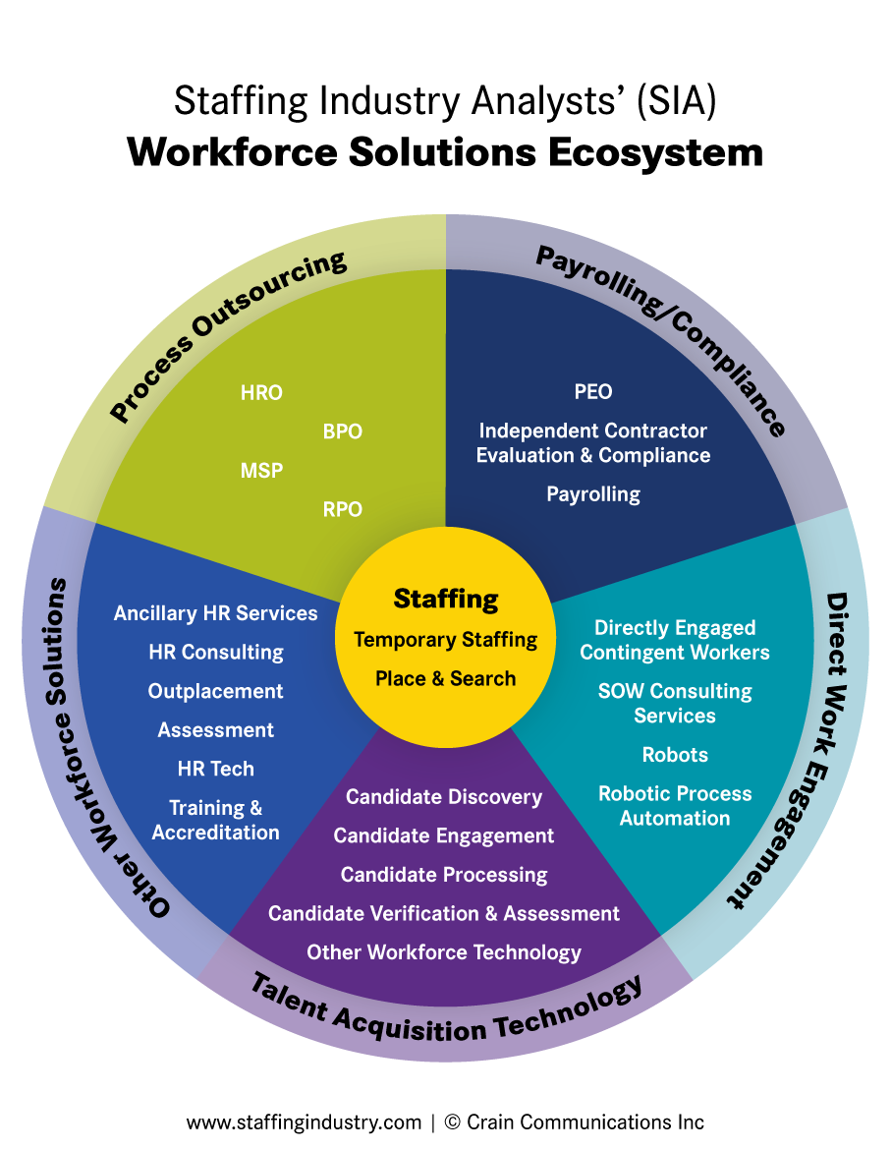
This chart highlights interconnected components of the Staffing Industry and other types of Workforce Solutions. It comprises six primary segments:
Staffing
Process Outsourcing
Payrolling/Compliance
Direct Work Engagement
Talent Acquisition Technology
Other Workforce Solutions

Slide 2
We have placed the Staffing Industry at the core of this Ecosystem though, of course, we realize that this will appear to be a somewhat biased perspective if the center of your particular universe lies elsewhere.
Within each segment are the products and services that comprise the segment.

Slide 3
How (your company name) fits within the Staffing Industry Analysts’ Workforce Solutions Ecosystem.
Place your company logo in the area that matches your services, then delete this box

