Slide 1
The Power of Data
Sponsored and presented by:
May 18, 2023
Notes:
The elevation of technology in the contingent workforce (CW) arena has given organizations like yours access to more data than ever before. While there may have been times when just having the data available was important, we now have the challenge of how to best leverage that data to make the most informed decisions. Join SIA analysts Chris Paden and Jenn Simon as we discuss DE&I data, dashboards, scorecards and total talent metrics that help contingent workforce programs harness the power of data. Learn how you and your team can best organize and present this critical information to boost and accelerate the power of data for your CW program.

Slide 2
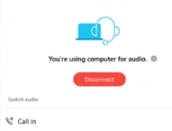
Audio
Listen through your computer through your speakers after you log into the event.
Want to change your audio? Click Audio options, click Switch audio, and then choose the option that you want to use.
Need assistance? Please send us a message in the
Q&A section or email memberservices@staffingindustry.com.

Slide 3
Questions?
Questions may be submitted at any time.
Click on the Question Mark section
to open the Q&A window.
Type your question into the small dialog box and click the Send Button.
The presentation will be shared with registrants.
Questions? Please email memberservices@staffingindustry.com
Notes:
If for some reason we run out of time to address your question, we will respond to you directly within a few days with an answer.
Question I get all the time – yes slides will be available – within 48 hours an email with a link will be sent to all registered attendees

Slide 4
Thank you to our sponsor…
Notes:
Thank you. Sevenstep is grateful for the opportunity to sponsor this session.
So, a brief bit about our organization. Sevenstep is a global talent solutions leader, with a strong presence in North America and EMEA. Though we’re well known in the RPO space, our MSP team brings client relationships that have extended over more than ten years.
A deep technology footprint, high client satisfaction and a culture of innovation have helped us keep our customers ahead of the curve. If you face uncertainty or challenges in your workforce plans, I encourage you to learn more about what we can do for you. Visit us at sevensteptalent.com.
And now, let’s talk about today’s session. As we all know, SIA’s expertise and relationships give it a unique grasp of the issues and opportunities associated with the extended workforce. And “the power of data” is at the center of nearly every one of those issues today.
Of course we all know that data, by itself, actually has no power at all. We look at it as potential.
But in putting that potential to work, employers, technology innovators and solutions providers are reshaping how companies engage the workforce. They’re aggregating data to better see the big picture. They’re applying context and interpretation for meaningful intelligence. And that leads to the frontier we find ourselves in today: turning workforce intelligence into business understanding.
How do you elevate from simple data reporting, to providing context for informed decisions, to, ultimately, providing an understanding to predict the best decisions? We have been working on that through our own proprietary Sevayo Insights technology (shameless plug). Our experience with our clients has proven that data truly does have the power to create the best outcomes.
Once again, we appreciate the work by SIA here today, and hope you all enjoy the session. Back to you.

Slide 5
Staffing Industry Analysts Product Overview
SIA | Staffing Industry Analysts Contingent Workforce Strategies Council Webinar
Notes:
We make the world of work better. SIA Informs Connects and Elevates the Workforce Solutions Ecosystem
I'm sure most of you will know who we are - SIA is the global advisor for staffing and workforce solutions. If not, you should be aware that we offer a range of research, advisory services, events, training and editorial content for staffing firms and buyers of workforce solutions. I am on the Contingent Workforce Strategies (CWS) Council team, a business intelligence and advisory service for corporate buyers of contingent labor. CCWP next class mention CE Credits SOW Int 3/8 CCWP 3/22
Upcoming buyer events: CWS Summit Europe May 9-10 London CWS Summit NA September 19-20, 2022, Collaboration in the Gig Economy The Omni | Dallas, TX and September 20-22, 2022

Slide 6
CWS Council (partial list)
Notes:
As of 4/13/23 verified by AN

Slide 7
Today’s Speakers
Chris Paden, Senior Director, Contingent Workforce Strategies Council
Jenn Simon, Workforce Strategies Research Director
Notes:
CHRIS PADEN
Chris Paden is the Sr. Director of Contingent Workforce Strategies Council for SIA, with primary responsibilities supporting the CWS Council for the Americas and focused on benchmarking best practices and providing advocacy for the industry while drawing from his direct experience implementing, managing and maturing over a dozen CW programs in his career, including CareFirst BCBS and Constellation Energy.
JENN SIMON
Jenn has over a decade of experience in procurement, talent acquisition, workforce management, total talent initiatives, and solutions. In her role as Director of Workforce Strategies and Research, Jenn’s primary focus will be the delivery of best practices and benchmarks to assist CWS Council members in the creation and development of their workforce solutions programs. Before joining Staffing Industry Analysts (SIA), Jenn was a Director of Operations for a global MSP organization, working with several industry-leading contingent workforce programs. Her responsibilities included managing VMS tools, staffing partnerships, and developing global staffing strategies and solutions for clients to implement contingent programs across NA, APAC, and the EMEA regions. Prior to her MSP experience, Jenn was the Senior Manager of Strategic Procurement for a large pharmaceutical company, where she managed the contingent workforce program (CWP), staffing partnerships and served as a Council member at SIA.

Slide 8
What to Expect in Today’s Webinar
Discuss Different Types of Data
Talent Intelligence
DE&I Metrics
Sourcing Metrics
Data Mandates
Operational Intelligence
Program Dashboards
Supplier Scorecards
Engagement Manager Scorecards
Market Intelligence
Pay/Bill Rate Data
Peer Benchmarking
Market Trends
Trends in Data
Data Best Practices
Your Providers Role in Data Success

Slide 9
Talent Intelligence
The process of collecting, analyzing and marrying internal and external data and using the insights to turn workers (regardless of status) into a competitive advantage. Put simply, talent intelligence helps companies understand the available talent pool, identify and select the best talent at the best cost, and engage in the thoughtful development and execution of an integrated talent sourcing and management strategy that actually delivers business results.
EXAMPLES:
Diversity Information
Sourcing
Mandates for Data

Slide 10
Use of workforce strategies, 2023 - Europe
 | Leaders | Laggards | Difference
Project to consider RPA | 41% | 8% | 33%
Direct sourcing of CW | 57% | 25% | 32%
Program to align CW to diversity goals | 52% | 21% | 31%
Trying out new staffing suppliers | 64% | 42% | 23%
Program for diversity suppliers | 64% | 46% | 18%
Company career site for attracting CW | 29% | 13% | 16%
Project to consider use of robots | 29% | 13% | 16%
Talent pools | 31% | 17% | 14%
Internally managed CW program | 46% | 33% | 13%
Consolidation of staffing suppliers | 69% | 57% | 13%
Global management of CW | 62% | 50% | 12%
CW as part of strategic planning | 28% | 21% | 7%
Program to encourage candidate diversity | 61% | 54% | 7%
Total talent acquisition | 14% | 8% | 6%
Employer branding | 43% | 38% | 5%
Supplier tiering | 67% | 67% | 0%
SOW included in CW program | 57% | 71% | -14%
Source: Workforce Solutions Buyer Survey 2023-Europe Results

Slide 11
DE&I Data Collection
DE&I leaders track diversity-specific measures including:
Diverse candidates in the applicant pool
Attrition rates by demographic groups
Diverse candidate interviews
Conversion Rates
Diverse Hires
Pay Rates
Redeployment Rates
Supplier strategy to capture candidate diversity profile
Supplier outreach to diverse talent sources
This Photo by Unknown Author is licensed under CC BY-SA

Slide 12
MSP Provider Capability
Service | % of providers offering service | % describing service as mature
Monitoring of diversity and inclusion within contingent workforce | 94% | 50%
Support client demand forecasting | 91% | 58%
Provision of regional / global workforce trend data | 88% | 70%
Program to increase diversity of contingent workforce | 86% | 50%
Pre-requisition decision tool to determine optimum worker type | 81% | 38%
Technology to identify best location of hire / worker | 78% | 67%
Source: MSP Global Landscape Report 2022
Notes:
This represents some questions that I ask all participants in the MSP Global landscape report in terms of the level at which they are providing services. All of these services are ways in which they can support incorporating contingent workforce into strategic planning. The order shown is the number of providers that provide each of these services.
What is interesting is that the number describing themselves as mature (i.e. it is a professional service that more than 50% Clients have in place) is relatively low across many of these services.
Mature = used by more than 50% of clients

Slide 13
MSP Partner Practices for DE&I Data
Attracting and retaining diverse talent to build a culture of inclusion
Determining the effectiveness of micro diversity within an organization
Acquiring a thorough understanding of your entire workforce and making use of underutilized talent
Recognizing actual problems to let your contingent workforce feel more human
Supporting broader DE&I goals and unlocking incremental ROI
Adoption of Artificial Intelligence (AI), Machine Learning (ML), and Robotic Process Automation (RPA)
Partnerships with industry experts
Benchmarking diversity stats
Supplier diversity programs
Supplier diversity reporting
Source: Best Practices in Contingent DEI

Slide 14
VMS Partner Practices for DE&I Data
Functionality for self-identification
Encrypted/anonymized data storage for
candidate information
Custom fields to reduce bias
Reporting and predictive analysis for
diverse talent
Public facing diverse talent pool creation
Accessibility for users with disabilities
Source: The Future of Diversity, Equity, and Inclusion in the Contingent Workforce

Slide 15
Sourcing Data
Labor Population Data
Availability of Skill Set
Best Location to Source in
Rate
Quantity
Demand
Notes:
Payrate Range Finder

Slide 16
Sourcing Data Example – SIA Payrate Range Finder Tool

Slide 17
Regulatory Influences on Data
GDPR
PRIVACY
PAY PARITY
The General Data Protection Regulation (GDPR) establishes a single set of rules on data protection for the 28 Member States of the European Union. Any organisation that handles the personal data of EU citizens is affected.
Any company established outside of the EU but offering goods or services to customers within the EU, or monitoring the behaviour of EU citizens, will have to apply the same rules. The maximum penalty for a breach of the GDPR is EUR20 million or 4% of worldwide turnover.
Data privacy and cybersecurity are high on the list of policy issues that most concern international CEOs. Corporations are spending significant resources not just on digital transformation but also on measures to ensure their networks and technology systems are protected against data breaches and cybercrime and to comply with increasingly stringent laws. Employers and staffing firms process vast amounts of personal data, so it is imperative to keep up to date with the latest legislation. The trend is towards more stringent comprehensive data protection regulation and stricter, more punitive enforcement.
Multiple countries, including Canada, Chile, France, Germany, Iceland, Lithuania, UK and the US, already have transparency legislation or policies in place. Other federal, national and local governments are in the process of enacting measures, including the European Union (EU) which is currently approving a Pay Transparency Directive. Pay transparency legislation is typically structured around nine legislative measures: access; pay disclosure; salary advertising; salary history ban; certification; pay gap reporting; gender and pay audits; pay assessments; and collective bargaining

Slide 18
Operational Intelligence
An approach to data analysis that enables decisions and actions in business operations to be based on real-time data as it's generated or collected by companies.
EXAMPLES:
Program Dashboards
Supplier Scorecards

Slide 19
Trends in Reporting
Visibility
Reporting
Analytics
1
FTP/ETL to API Integrations
Real Time Exchange
Standard Configuration
Published Protocols
2
Business Intelligence Tools
Integrated into VMS
Single Warehouse/Tool
3
Artificial Intelligence
Machine Learning
Deep Learning

Slide 20
Tenants of Good Data
1
REPRESENTATIVE
5
ACTIONABLE
2
COMPREHENSIVE
6
OBJECTIVE vs SUBJECTIVE
3
TIMELY
7
PREDICTABLE
(LEADING vs LAGGING)
4
STRUCTURED/GOVERNED
Notes:
Representative
Timely
Comprehensive
Structured/Governed
Objective vs Subjective
Predictive (Leading Vs Lagging Indicators
Actionable

Slide 21
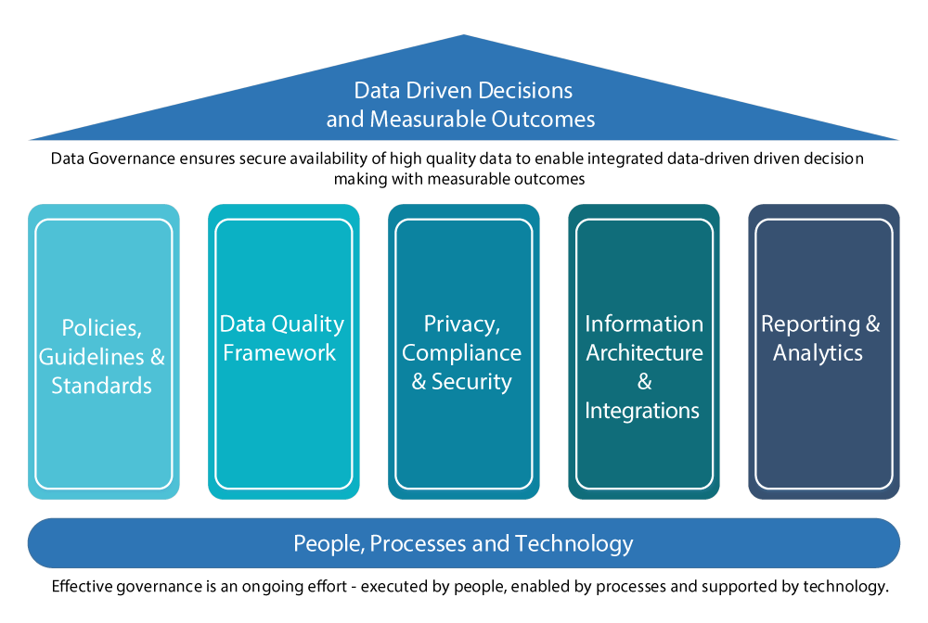
Data Governance
Source: University of British Columbia Office of the CIO

Slide 22
Program Dashboard Metrics
Quality
NPS
Worker
Efficiency
Time to X
Cost
Spend (Invoice vs Budget)
Savings
Supplier
Fill
Respond
Approve
Business Specific
Workforce Demographics
Compliance
Risk Indicators
Locations
Skills
Worker Type

Slide 23
MSP / VMS Metrics
MSP METRICS
VMS METRICS
Service levels
Ability to fill requests on time
Talent Quality: Right skills
Talent Quality: Right price
NPS and CSAT levels
Response times
System down time/speed
Enhancements/Pace of innovation
Customer service delivery/uptime guarantee
Change management capability
Pace of innovation
NPS and CSAT levels

Slide 24
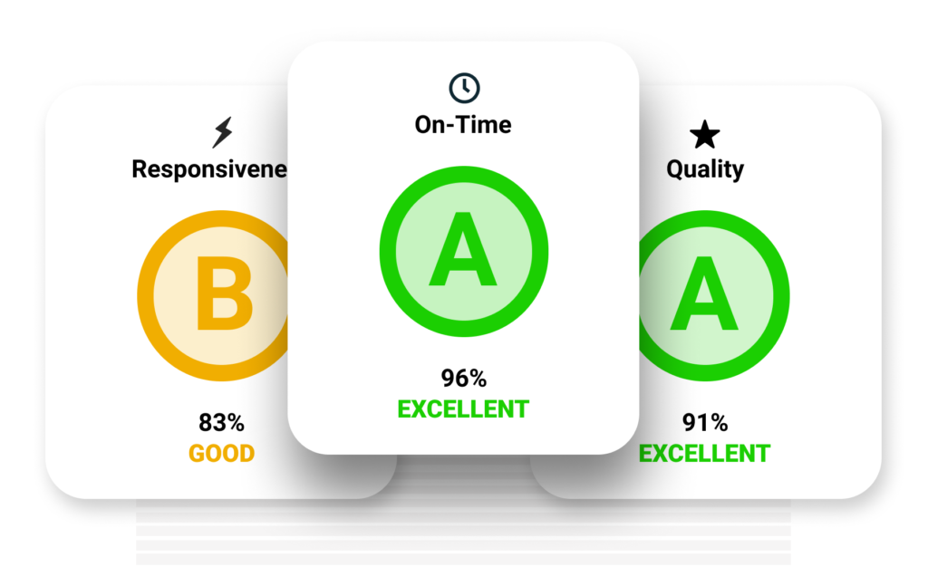
Staffing Supplier Scorecard Metrics
Sample of vendor scorecard metrics are:
Percent of requisitions submitted against
Average number of candidates submitted per requisition
First work order cancellations
Average days to respond
Number of candidate submittals to interviews
Percent of placements
Percent of negative attrition (Unplanned Turnover)
Percent of positive attrition (Conversions)
Bill rate adherence

Slide 25
Engagement Manager Scorecard Metrics
Some examples of engagement manager scorecards and metrics are:
Request/work order approval time
Timesheet approval time
Time to review candidates
Time to select final candidate
Percentage of completed assignments
Early terminations
Number of interviewed candidates

Slide 26
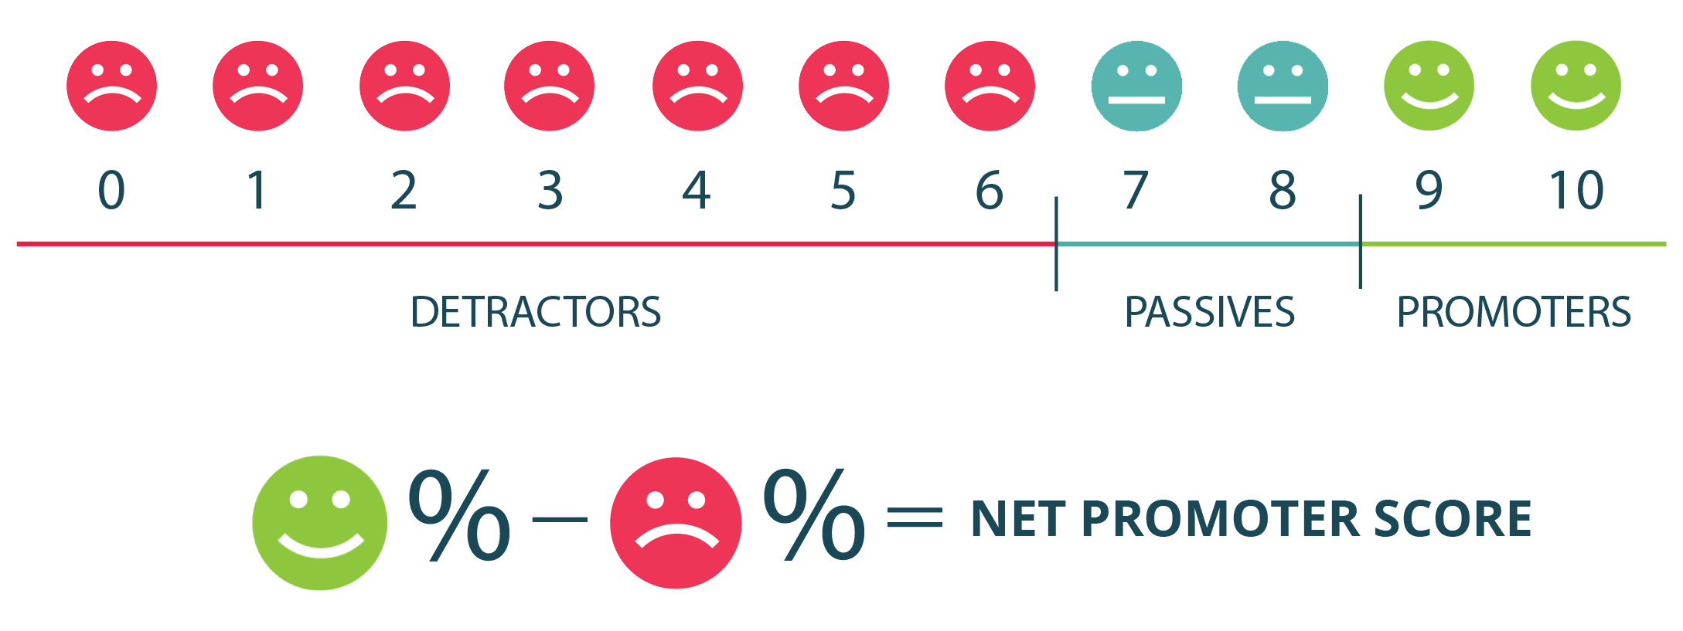
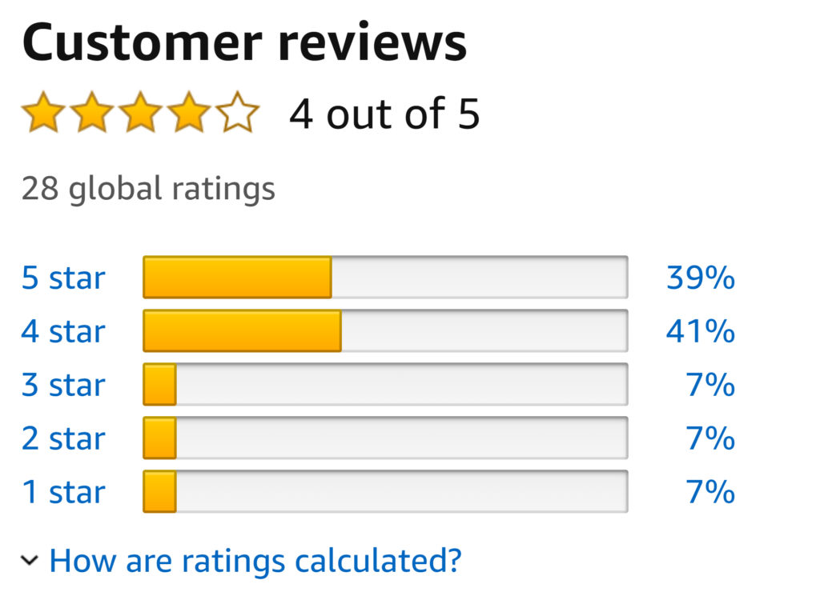
Customer Satisfaction Programs
Have a Purpose
Be Timely & Considerate
Consider all Stakeholders
Automate Where Possible
NET PROMOTER SCORE (NPS)

Slide 27
Staffing Industry NPS
Segment | NPS
Staffing Agency | -11
MSP | -31
VMS | -39
HRIS | -41
Job Board | -50
ATS | -53
ERP | -55
Talent Platform | -59
RPO | -63
Source: SIA 2023 Global Workforce Solution Buyers Survey

Slide 28
Market Intelligence
The information or data that is derived by an organization from the market it operates in or wants to operate in, to help determine industry segmentation, penetration, opportunity, and existing market metrics.
EXAMPLES:
Bill/Pay Rates
Peer Benchmarking
Job Trends
Assessments
Legal Alerts

Slide 29
Workforce Analytics
Benchmarking for pay and bill rates across job titles, years of experience, and location for contingent and non-contingent workers
Creates oversight of talent pipeline quality, identifies hidden talent and those at risk of leaving
AI-based talent intelligence platform unifies internal, external, and contingent talent data to provide insights
Data analytics tools for actionable insights to succeed in workforce planning, talent acquisition and compensation targets
Customised benchmarks for labor market pay, bill and markup rates in real time with focus on contingent labour
Labor market analytics tool scraping government data overlayed with large-scale jobseeker survey data across Europe

Slide 30
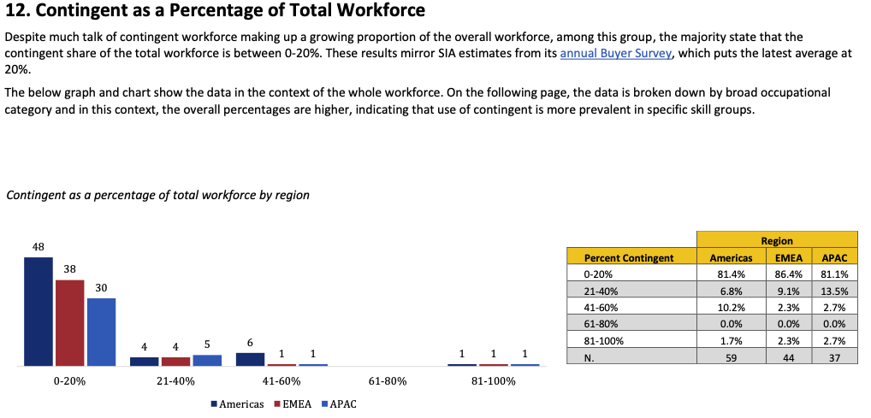
Program Performance Indicator Survey

Slide 31
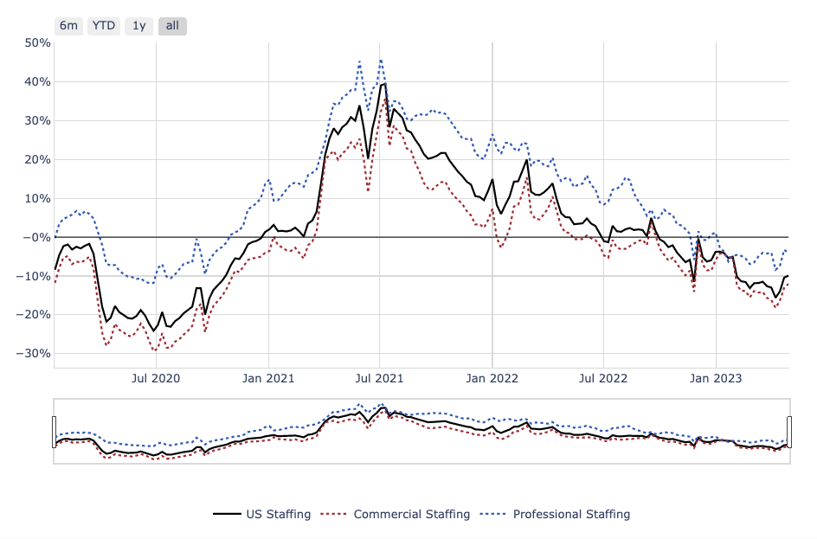
Bullhorn Indicator
Released weekly, the SIA | Bullhorn Staffing Indicator comprises two sets of analyses; a Year-over-Year comparison showing how the week that ended ten days ago (“last week measured”) compares to the same week 12 months previously and an indexed value that has been benchmarked against data from the week ending January 13th, 2019.

Slide 32
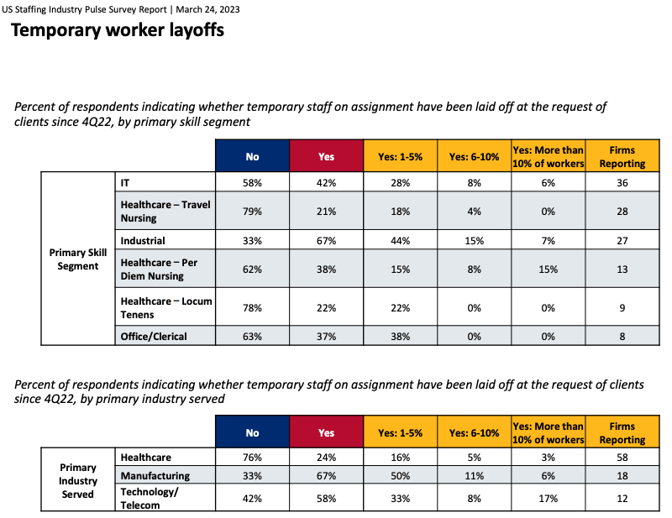
Pulse Survey
Released monthly, the SIA Staffing Industry Pulse Survey Report measures timely growth trends in the US temporary staffing, direct hire and retained search markets. Responses are collected from provider organizations while keeping individual company data confidential.

Slide 33
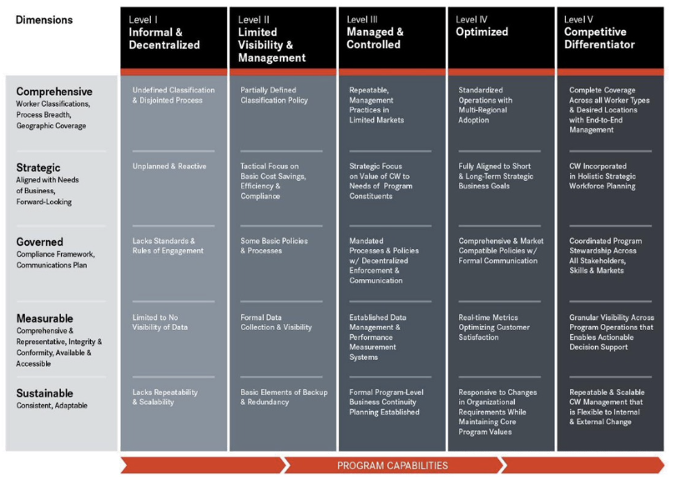
Workforce Solution Ecosystem Assessment
A multi-dimensional tool to assess an organization’s contingent workforce program capability and performance using five levels of capability ranging from level 1 (Informal & Decentralized) to level 5 (Competitive Differentiator).
The assessment focuses on all aspects of contingent labor/external workforce and the degree in which they are formally managed by someone in your organization.
The output is a comprehensive index of benchmarked objectives tailored to your organization's greatest opportunities.

Slide 34
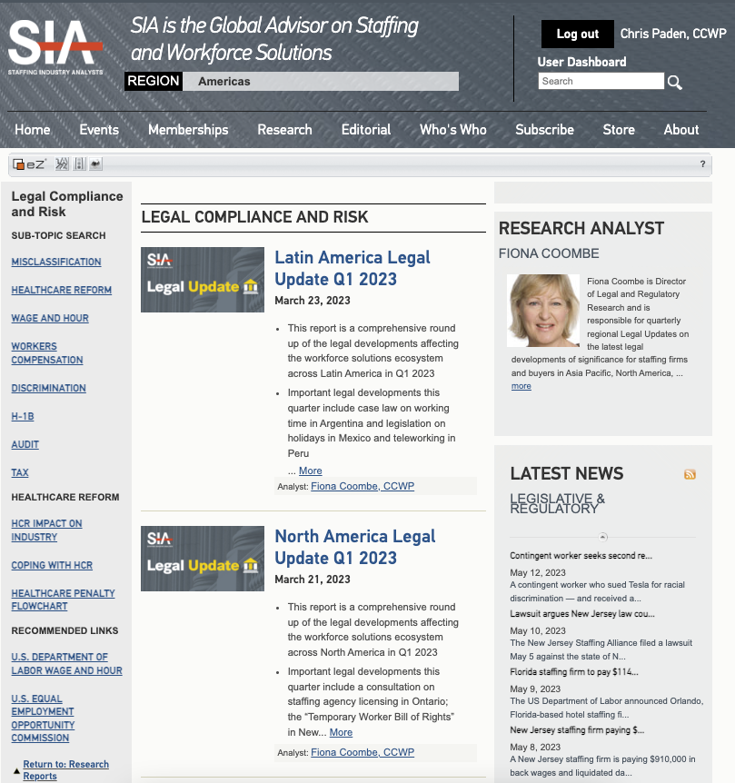
Legal Alerts

Slide 35
Risk Assessment
Distribution of Risk Elements by Level and Category

Slide 36
Time for your questions…

Slide 37
Thank you to our sponsor…

Slide 38
SIA MEMBER RESOURCES
Workforce Solutions Buyer Survey 2023-Europe Results
The Future of Diversity, Equity, and Inclusion in the Contingent Workforce
Best Practices in Contingent DEI
MSP Global Landscape Report 2022
Workforce Solutions Buyer Survey: 2023 Americas Results
Developments in Data Privacy: 2022 Global Update
Global Pay Transparency Laws
Workforce Engagement Decisioning Tool
CW Program Business Case Template
VMS RFP Template
MSP RFP Template
Need access? Contact the SIA Council team: enterpriseservices@staffingindustry.com
Notes:
Updated 7/11 CP

Slide 39
SEPTEMBER 18-19, 2023
The Omni | Dallas, TX
#CWSSummit
Register at www.cwssummit.com

Slide 40
Copies of the slides and a link to the audio recording will be distributed to all attendees within 48 hours following the webinar.
A replay of this webinar will be available for our CWS Council and Premium Corporate members at: www.staffingindustry.com/webinars-buyer

