Slide 1
Why VMS? Why Now? COVID-19's Impact on Contingent Workforce Management
Sponsored & Presented by:
October 8, 2020
Notes:
When a crisis strikes or an emergency occurs, workforce continuity becomes a top priority. Join us for Part 1 of a two-part webinar series as we explore why the benefits a VMS provides are more important now than ever.
In the first webinar we will explore the 5 primary benefits of a VMS and how they can empower your business continuity plans. Learn through real-life examples how businesses are leveraging technology to build a more resilient, more responsive workforce in perilous times.

Slide 2
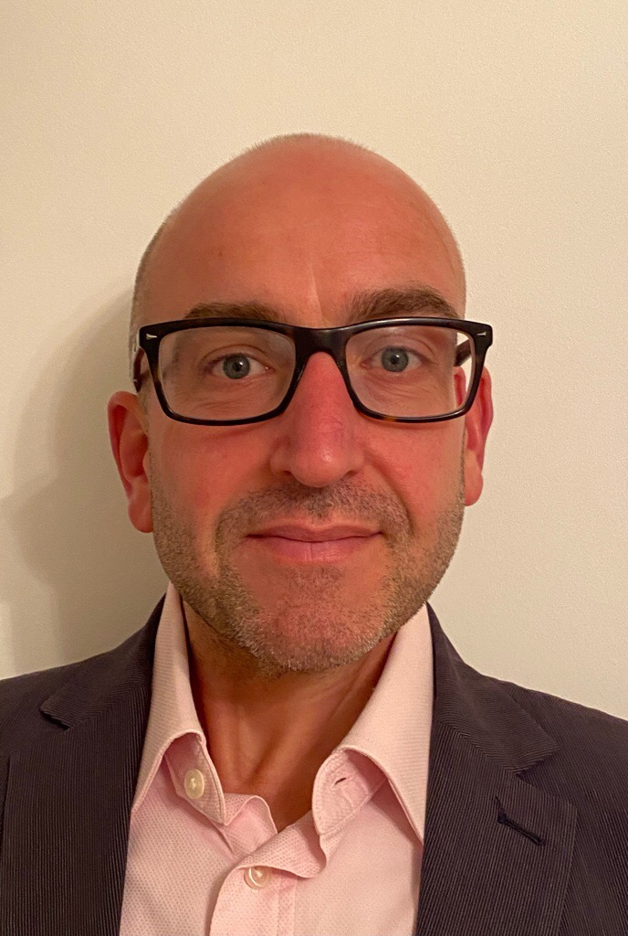
Speakers:
Alastair Dobson, Client Relationship Manager, Beeline Europe
Ian Lunt, Director of Project Management Office, Beeline
Moderator:
Peter Reagan, Sr. Director of Contingent Workforce Strategies & Research, SIA
Notes:
Alastair Dobson, Senior Client Relationship Manager, Beeline UK-based workforce management expert, with 15 years' experience in relationship management, solution design, operational delivery, implementation, sales and executive leadership in the VMS and MSP industry. With the advent of a total talent agenda, and the need for businesses to scrutinise all applicant routes, the role of workforce management providers has never been more vital. Whether it is navigating an ever-increasing regulatory environment, identifying, re-classifying and qualifying diverse pools of talent both internal and external, or selecting and correctly engaging with relevant technologies to collate and interpret the huge volumes of data attraction and recruitment now produces, we perform at our best when we have insight into key client drivers and can help them to predict future needs.
Ian Lunt, Director of Project Management Office at Beeline
Ian is the Director of Project Management Office and Client Service Services at Beeline and is based in our London office. Ian heads up our team of Project Managers and Client Operations Managers, delivering high quality service to our client base in EMEA. Bringing nearly 20 years of industry experience Ian has proven experience of leading multi-territory implementations and change programmes. An expert in leading and managing the full life cycle of VMS implementation projects from initial inception and design through to successful delivery and benefit realisation.
Prior to joining Beeline Ian was Head of Project Management for Hays Talent Solutions – managing a team of Project Managers, leading the implementation of complex Managed Service Provider (MSP), Recruitment Process Outsourcing (RPO) and Recruitment Technology change projects.

Slide 3
Notes:
Now a little about the SIA world. As many of you know already, SIA is the global advisor for staffing and workforce solutions. We offer a range of events, research and editorial products for staffing firms and buyers focused specifically on staffing and solutions. Our members enjoy access to our objective research and analysts, event discounts, editorial publications and advisory services. I see many of our members online today, thank you all for tuning in, members will get access to any research mentioned today plus incredible discounts to our events.

Slide 4
CWS Council (partial list)
Notes:
Rev 04/11/2018

Slide 5
Audio
Listen through your computer through your speakers after you log into the event.
Want to change your audio? Click Audio options , click Switch audio, and then choose the option that you want to use.
Need assistance? Please send us a message in the
Q&A section or email memberservices@staffingindustry.com.
SIA | Staffing Industry Analysts Contingent Workforce Strategies Council Webinar

Slide 6
Questions?
Questions may be submitted at any time.
Click on the Question Mark section
to open the Q&A window.
Type your question into the small dialog box and click the Send Button.
The presentation will be shared with registrants.
Questions? Please email memberservices@staffingindustry.com
Notes:
We want to hear from you and make sure this webinar addresses your questions. So please submit them ongoing throughout the webinar. If we do not get to your question we will answer it after the webinar via email. The question we usually get first is when will we share the slides? They will be available on the SIA website approximately 48 hours post webinar and a link will be sent to you after the session.

Slide 7
Why VMS? Why Now? COVID-19's Impact on Contingent Workforce Management
Sponsored & Presented by:
October 8, 2020
Notes:
When a crisis strikes or an emergency occurs, workforce continuity becomes a top priority. Join us for Part 1 of a two-part webinar series as we explore why the benefits a VMS provides are more important now than ever.
In the first webinar we will explore the 5 primary benefits of a VMS and how they can empower your business continuity plans. Learn through real-life examples how businesses are leveraging technology to build a more resilient, more responsive workforce in perilous times.

Slide 8
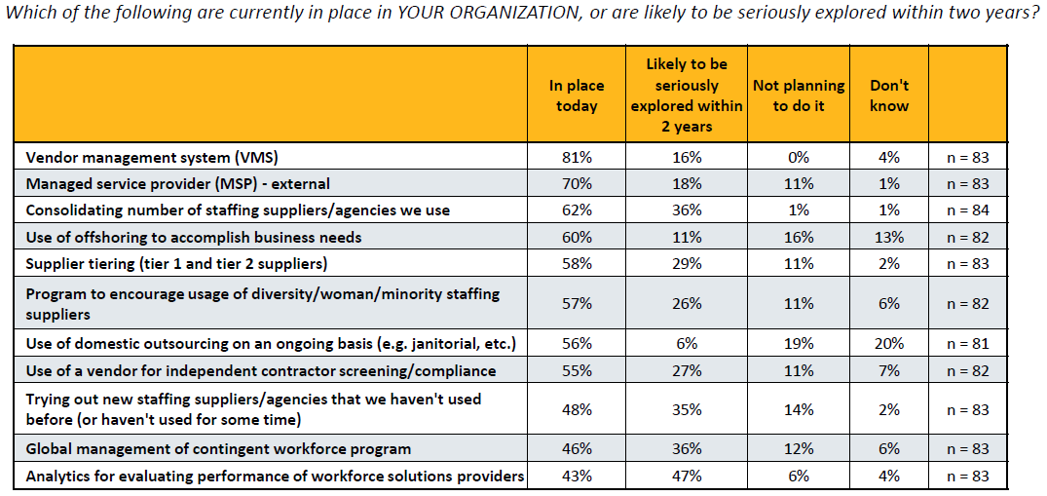
2018 Buyers Survey - EMEA
Notes:
We asked large companies: “Which of the following are currently in place in your organization, or are likely to be seriously explored within two years?” Respondents were shown the workforce management strategies in the chart.

Slide 9
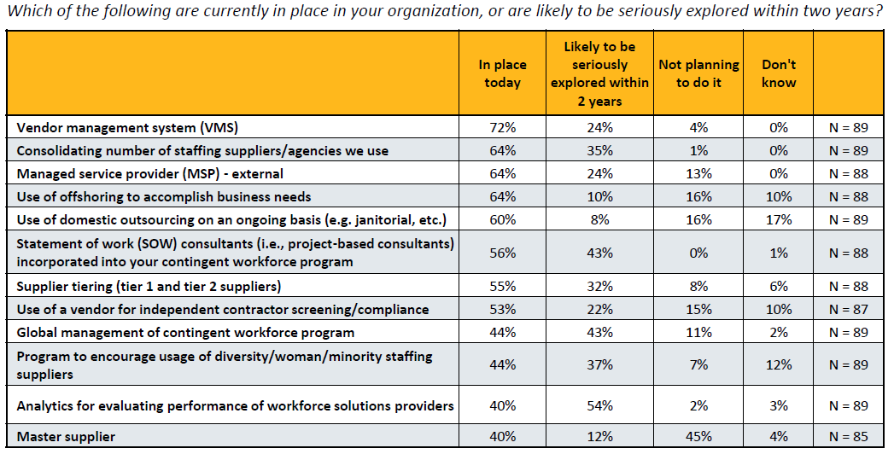
2019 Buyers Survey - EMEA
Notes:
•The most used is the vendor management system (VMS), technology that helps businesses manage and procure talent through staffing suppliers and other providers. 72% of respondents noted they currently have one in place; an additional 24% noted they are likely to seriously explore the idea within two years.
Only a small fraction chose one of the other two options: “Not planning to do it” or “Don’t know”.
•MSP (managed service provider) ranked third in terms of being in place today, with 64%. That number could go up or down over the next few years.
While an additional 24% are exploring the use of MSP, further usage could be offset by a shift among those currently using an external MSP to internally managed programs; more than two-thirds of the 18% exploring the use of an internally managed program noted they currently have an MSP in place.

Slide 10
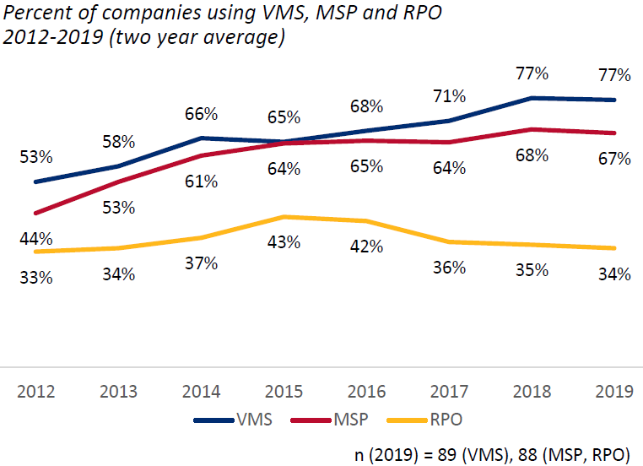
2019 Buyers Survey - EMEA
Notes:
The graph at right shows the percent of surveyed companies that reported use of a VMS, MSP, and RPO from 2012 to 2019, based on a two year average. Because the graph uses a two year average, results for 2019 may differ from those shown on page 12.
•While more than two-thirds of respondents each report the use of VMS and MSP, RPO has not gained the same degree of traction.

Slide 11
WHY VMS? WHY NOW?
COVID-19’s impact on
Contingent Workforce Management
8 October 2020
Beeline.com | Confidential & Proprietary

Slide 12
Our Speakers
Alastair Dobson
Ian Lunt
Senior Client Relationship Manager
Director of Project Management Office
Beeline.com | Confidential & Proprietary

Slide 13
Agenda
Ensuring workforce continuity in a crisis
Five problems you need to solve – now
Innovative solutions for difficult times
Recommended next steps
Q&A
Beeline.com | Confidential & Proprietary

Slide 14
Why is Workforce Continuity suddenly a top priority?
It’s a key to Business Continuity – whether your company can continue to operate
Your workforce is not only your largest single operating expense – it is your greatest competitive asset
How you manage this asset will likely determine whether your company survives – or thrives
Notes:
Business continuity goes through 3 phases:
Respond: react to immediate impact
Recovery: scale up (or up-down-up)
Reimagine: innovate (by necessity or by design) – this is the part that requires seeing your workforce with eyes on the future, not the past.
(By the way, Gartner calls these stages “1. Respond, 2. Recover, 3. Renew.” I like our McKinsey-based version better.)
Workforce continuity is vital, because your people are your greatest asset
If you had a plan, is it still valid? If you don’t have a plan, now is the time to start.

Slide 15
The 5 workforce management problems you need to solve - NOW
1. Visibility
2. Compliance
3. Cost Control
4. Quality
5. Operational Efficiency

Slide 16
Visibility
Notes:
Do you know every non-employee who is working for your company?
Do you know where they are?
Do you know what they are doing and what access they have to your facilities, your networks, and your data?
You need to be able to answer all these questions right now.
Ensuring 100 percent workforce visibility is the first and most urgent
problem you must solve, but it is not the only one.

Slide 17
Compliance
Notes:
You must ensure that each of your workers is properly classified and your compliance records are audit-ready.
Nothing is more likely to compound your workforce continuity challenge – or to focus your executives’ attention on your program – than the risk of litigation or adverse publicity during a pandemic.

Slide 18
Cost control
Notes:
Containing costs is always important, but for companies shifting their operating models to navigate this crisis, cost control, cost reduction, and cost avoidance may now determine which companies will survive and thrive.
Since human capital is typically a company’s largest single operating cost and non-employee workers represent nearly half of a typical company’s workforce, contingent labor management is now truly in the eye of the storm.

Slide 19
Quality
Notes:
Now more than ever your company needs the best performance from employees and non-employees alike.
For those responsible for managing staffing suppliers, contingent workers, and contractors, this means you must have the right systems in place to monitor, measure, and report on the quality of work performed and be able to prove to your stakeholders that you are receiving everything you are paying for.

Slide 20
Operational
efficiency
Notes:
It goes without saying that you need a streamlined, automated, repeatable, error-free process for sourcing and managing all your contingent talent.
But during times of crisis, business operations are being tested by rapidly evolving challenges, especially with large-scale remote working a reality. At times like these, technology that automates key contingent staffing and services procurement
processes can be more than a time-saver; it can be a company-saver.

Slide 21
Innovative solutions for difficult times
Some of the responses we have seen from our clients:
Resource Tracking implemented to ensure 100% contingent workforce visibility
Regional VMS solutions to manage workers in low-headcount locations
Services procurement implemented to track contractors and compare efficiency of SOWs vs contingent staff

Slide 22
COVID-19 response for Beeline clients 7 new Beeline VMS features now available to support workforce continuity
“We recently requested a new timesheet earning code be set-up for COVID-19 related absences. Beeline turned that request around in a day. I just wanted to give my appreciation to Beeline on their response to the pandemic.”
CWS Technology Specialist, Human Resources, FORTUNE 500 manufacturer
Headcount Visibility – a no-cost temporary solution to provide automated access and reporting on our clients’ untracked global headcount.
Remote Eligibility Field – Client Defined Field for clients who are not already tracking workers working (or equipped and capable of working) remotely.
Position Criticality Field – Client Defined Field to denote essential/critical positions.
Workforce Continuity Reports - to reflect worker headcount by geography and remote-eligible positions, as well as essential/critical services.
Covid Earning Codes – for furloughed positions, etc.
Physical Work Location – to make instantly visible whether a worker is on-site or remote.
Quick Stand Up Private Talent Pool – a no-cost temporary solution to protect your brand reputation and to access and engage on-demand talent quickly when the crisis is over.
Notes:
Let us just share a few things that we have done - In the early stages of Covid we saw clients needing additional information around their workforce immediately to be captured in reports and critical info needed to manage new regulatory requirements associated. These features listed have been captured by fields in the VMS add-ins including:
These were captured by the VMS add-ins including:
COVID earning codes
Critical position codes
Client-defined business continuity fields
COVID dashboards and reports
Disaster relief overtime codes
Tenure exception fields
We also made it possible for Beeline customers to stand up Headcount visibility & Private talent pools at no cost for 2020.

Slide 23
Recap
Workforce continuity is always important, but now it is vital
We don’t know everything about the “new normal,” but we know enough to plan
Implement solutions now to address 5 most urgent problems
Plan to make your new workforce more resilient and more agile
Understand what you will need to turn your plans into reality
Beeline.com | Confidential & Proprietary

Slide 24
MOVING FORWARD
Assess your situation and set priorities
Talk with your peers
Engage experts with broad industry perspectives: SIA, your MSP, your VMS partner
Prepare your plans – and start building your business case
Take action

Slide 25
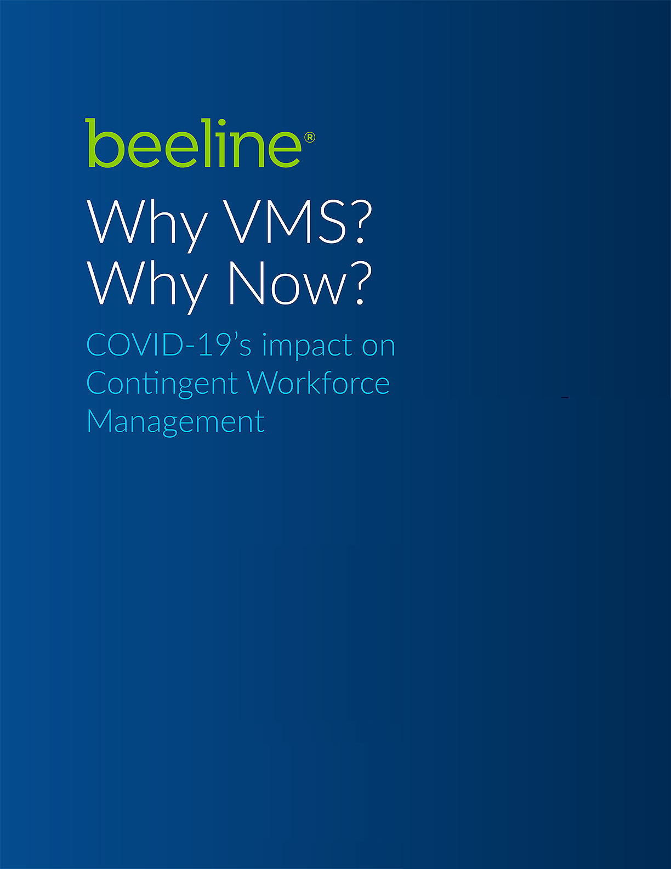
For more information
Download our free ebook
Why VMS? Why now?
https://bit.ly/35XBQQt
or visit beeline.com
for industry reports, whitepapers, case studies, eBooks, and more.

Slide 26
Questions?
Beeline.com | Confidential & Proprietary

Slide 27
Elements of a post-crisis workforce plan
How will your new workforce be more agile than before?
Will you make more strategic use of:
Consultants?
Professional and support service contractors?
Independent contractors?
Contingent or temporary staff?
Will you plan your workforce mix around specific outcomes?
Will you use private talent pools to reduce cost and time to fill open positions?
Will you use Regional VMS or Resource Tracking to ensure 100% workforce visibility?
Will you be prepared for future coronavirus waves?
Why plan now? Because your customers and your competitors won’t wait.

Slide 28
SIA CWS Council Member Resources Not a member? Contact the SIA CWS Council team at enterpriseservices@staffingindustry.com
VMS Global Landscape Summary 2019
VMS RFP Template
MSP and VMS Provider Directory 2020 COVID-19
Workforce Manager Responses and Intentions Survey 2020
Workforce Solutions Buyer Survey (EMEA): 2019 Full Report
Coronavirus (COVID-19) Resource Center
CW Programs and Disaster Preparedness

Slide 29
View the full schedule of classes at:​ www.staffingindustry.com/certification​
@SIACCWP #CCWP​
Virtual Interactive CCWP Classes​ Use your time away from the office to be informed, connected and elevated to the entire workforce with our Virtual Interactive CCWP classes. Sessions are live and interactive and streamed direct to your desktop. Whether you are in HR or Procurement, an MSP, VMS, or Staffing provider, our CCWP classes offer an accreditation that will elevate your career to the next level.
Register Today!
www.staffingindustry.com/certification

Slide 30
INTELLIGENCE FOR REAL RESULTS
The Contingent Workforce Strategies (CWS) Council is a business intelligence and advisory service for corporate buyers of contingent labor and workforce solutions.
As a CWS Council Member, you have access to a wide range of regional research with content most relevant to your business, including:
• VMS/MSP • SOW management strategies
• Globalization • Workforce planning and talent management
• RPO best practices • Program benchmarking
Learn more about becoming a Contingent Workforce Solutions (CWS) Council Member Today! +44 (0)20 823 9900 | enterpriseservices@staffingindustry.com | @SIAnalysts

Slide 31
Industry Insights from the Comfort of Your Office!
Webinars focus on a variety of relevant contingent labor topics from industry developments and forecasts to ideas, techniques and insights.
Upcoming Webinars
October 15(Americas)
October 22 (Americas)
November 19 (Americas)
November 24 (APAC)
December 3 (Global)
View webinar topics and sign up at: www.staffingindustry.com/webinars-buyer

Slide 32
Copies of the slides and a link to the audio recording will be distributed to all attendees within 48 hours following the webinar.
A replay of this webinar will be available for our CWS Council and Premium Corporate members at: www.staffingindustry.com/webinars-buyer

Slide 33
About Staffing Industry Analysts (SIA)
Founded in 1989, SIA is the global advisor on staffing and workforce solutions. Our proprietary research covers all categories of employed and non-employed work including temporary staffing, independent contracting and other types of contingent labor. SIA’s independent and objective analysis provides insights into the services and suppliers operating in the workforce solutions ecosystem including staffing firms, managed service providers, recruitment process outsourcers, payrolling/compliance firms and talent acquisition technology specialists such as vendor management systems, online staffing platforms, crowdsourcing and online work services. We also provide training and accreditation with our unique Certified Contingent Workforce Professional (CCWP) program.
Known for our award-winning content, data, support tools, publications, executive conferences and events, we help both suppliers
and buyers of workforce solutions make better-informed decisions that improve business results and minimize risk.
As a division of the international business media company, Crain Communications Inc., SIA is headquartered in Mountain View, California, with offices in London, England.
For more information: www.staffingindustry.com
For global coverage across the workforce solutions ecosystem, follow us and connect via
@SIAnalysts
PROPRIETARY DATA, DO NOT DISTRIBUTE OUTSIDE YOUR ORGANIZATION. Your company’s use of this report precludes distribution of its contents, in whole or in part, to other companies or individuals outside your organization
in any form – electronic, written or verbal – without the express written permission of Staffing Industry Analysts. It is your organization’s responsibility to maintain and protect the confidentiality of this report.
Staffing Industry Analysts | 1975 W. El Camino Real, Ste. 304 | Mountain View, CA 94040 | 800.950.9496 | www.staffingindustry.com
SIA | Staffing Industry Analysts Contingent Workforce Strategies Council Webinar

